Slide 1
Design Patterns
Unit 09
The Prototype Pattern

Slide 2
Objectives
In this lesson, you will learn to:
Prototype Pattern (Creation Pattern)

Slide 3
The Prototype Method Pattern
Intent
  The Prototype design pattern creates new instances of classes by initialized prototype instances copy or clone themselves.
  Useful when creating an instance is usually:
    Time-consuming
    Very complex
  Class copies itself
    Process can be largely ignored by the creator

Slide 4
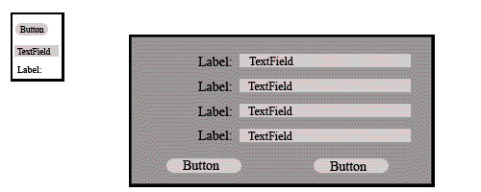
The Prototype Method Pattern
Motivation
  An example of the Prototype design pattern would be in a GUI building tool
  For each graphic element which the user may customize and add to the application interface (buttons, text boxes, etc.), the user has many options to choose for style, color, font, size, etc.

Slide 5
The Prototype Method Pattern
Motivation
  Keep a single prototype of each GUI element on a palette (调色板) for the user to choose from, which allows the user to customize each type once and drag them onto the interface project as desired.
  Not only does this produce a consistent look and feel across the application, but the GUI building tool need only call the instance's clone() method each time it is dragged from the palette to the GUI, regardless of the specific class selected by the user.

Slide 6
The Prototype Method Pattern
Applicability
  Useful to design a system independent of how its objects are created, composed and represented
  Dynamic object specification (规范化)
    Specify the general class needed, but defer specifics until execution time
  No class hierarchies of "factory" classes are needed
    Can avoid building a class hierarchy of factories paralleling the class hierarchy of products

Slide 7
The Prototype Method Pattern
Few different combinations of state in class instances
  May be more convenient to install a prototype for each state and clone them, rather than instantiating the class manually, each time with the appropriate state
  Useful when construction and initialization of an object is more complex or time-consuming than simply cloning an existing object
Dynamic attribute specification for concrete class objects
  Cloned concrete product object will have a complete copy of the prototype instance's state
  Client can also specify attribute changes at creation time
  Initialization method parameters: "copy with changes capability"

Slide 8
The Prototype Method Pattern
Allow automatic extension of the class inheritance tree for product classes
  Automatically accommodate (适应) all subclasses of concrete classes
  Creation logic is always attached to the concrete product class in clone() methods
  Not in a separate concrete "factory" class

Slide 9
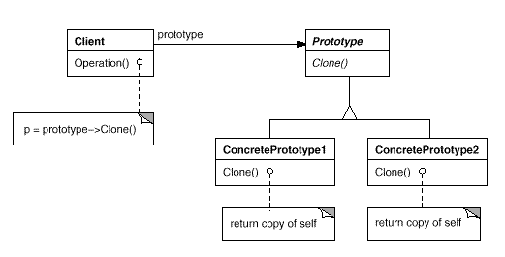
The Prototype Method Pattern
Structure

Slide 10
The Prototype Method Pattern
Participants
  Client - The client object asks the prototype to clone itself
  Prototype - Data object defining an interface for creating clones of its self
    A "clone" function, returning a copy of the original object
  ConcretePrototype - Implements the cloning operation defined in the Prototype class
    Copies the data and state of the original object

Slide 11
The Prototype Method Pattern
Collaborations
  Collaborations between participants are initiated by the Client
  Prototypical instance of any ConcretePrototypes to be used are created
    Initialized to the desired state of an instance typical for the Client's use
  Prototype is cloned whenever a new instance of this type is desired

Slide 12
The Prototype Method Pattern
Consequences of using the Prototype design pattern
  Alternative to Abstract Factory (and Builder, somewhat)
    Instantiation code not in a separate concrete "factory" class
  Isolates product (data) class details from the client for instantiation
    Streamlines (简化) client-side code for product instantiation process
    Eliminates case-by-class (一个案例接着一个案例←→one by one) handling of instantiation (same method)
    Requires a clone (or getClone) method in each Prototype subclass
      Difficult to reuse preexisting classes or those from external sources
      A deepClone() method virtually requires all the member values of the Prototype subclass be declared to implement Serializable
      Classes with circular references to other classes can’t really be cloned

Slide 13
The Prototype Method Pattern
Every Prototype subclass instantiated has a minimum of two instances
  All used by client must be created as a prototype first
  Possible performance drawback with large or many subclasses
Client can be configured with Prototype subclasses dynamically
  Can allow loading external classes into an application dynamically
  Works well with offline (脱机的) or distributed object registries
Prototype subclass member values may require more access methods
  Any value that may differ from the prototype must be changed through access methods rather than constructors

Slide 14
The Prototype Method Pattern
Implementation issues of the Prototype design pattern
  Determine mechanism for generation, management, and access of initial prototype instances by client:
    Generated externally, passed to client process
    Managed by a prototype manager including prototype creation

Slide 15
The Prototype Method Pattern
Determine clone operation mechanism
  Shallow copy (when prototype uses shared variables)
  Deep copy (when member values are cloned)
    Safeguard against possible circular references in member variables
Modification of initial state of prototype member values
  Allow access methods to concrete instances data
  Or implement a re-initialize function to call after a clone operation

Slide 16
The Prototype Method Pattern Example 1
Sample Code
  Client - The client object asks the prototype to clone itself
public class Client {
private ConcretePrototype cpPrototype = new ConcretePrototype();
. . .
current = cpPrototype.getClone();
. . .
}

Slide 17
The Prototype Method Pattern Example 1
Prototype - Data object defining an interface for creating clones of its self
public class Prototype implements Cloneable {
//protected ClassMemberValue memberValue;
public Object clone() {
try {
Prototype cloned = null;
cloned = (Prototype) super.clone();
//cloned.memberValue = memberValue;
// or use deep copy
return cloned;
}

Slide 18
The Prototype Method Pattern Example 1
catch(Exception e) {
System.out.println(e.getMessage());
return null;
}
}
public Prototype getClone() { // Can be abstract
Prototype cloned = null;
cloned = (Prototype) this.clone();
return cloned; // May be NULL
}
}

Slide 19
The Prototype Method Pattern Example 1
ConcretePrototype - Implements the cloning operation defined in the Prototype class
  Copies the data and state of the original object
  public class ConcretePrototype extends Prototype {
  //protected ClassMemberValue subclassSpecificAttribute;
  public ConcretePrototype getClone() {
  ConcretePrototype cloned = null;
  cloned = (ConcretePrototype) super.clone();
  //equivalent to: cloned = super.getClone();
  //cloned.subclassSpecificAttribute = subclassSpecificAttribute;
  // Or use deep copy
  return cloned; // May be NULL
  }
  }

Slide 20
The Prototype Method Pattern
Known Uses - Known examples of the Prototype design pattern
  A large list can be found in:
    Elena Fanea, David Baker, "Prototype Design Pattern", http://pages.cpsc.ucalgary.ca/~faneael/Prototype_document.htm
    Unidraw, described in [Vlissides, J., Linton, M.A., 1990 - Unidraw: A Framework for Building Domain-Specific Graphical Editors, ACM Transactions on Information Systems, Vol. 8, No. 3, pp. 237-268, ACM Press.
    Framework for creating graphical editors. It can be applied for technical and artistic drawing, music composition, and circuit design. In Gamma et al. is presented an example of musical composition using Unidraw. The Prototype description example presented here (Prototype Motivation).

Slide 21
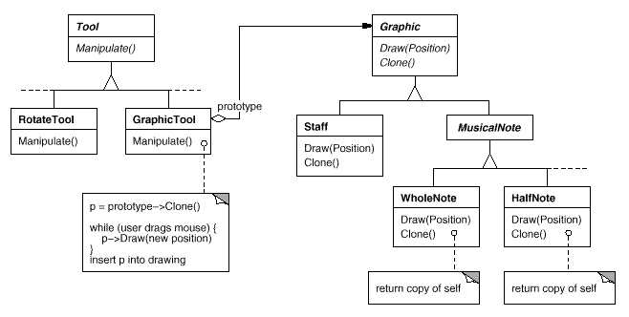
The Prototype Method Pattern Example 2
Known Uses

Slide 22
Shallow Clone 3
Shallow Clone
public class GoldRingedStaff implements Cloneable {
public GoldRingedStaff() { … } // constructor
public void grow() {
this.diameter *= 2.0;
this.height *= 2;
}
public void shrink() {
this.diameter /= 2;
this.height /= 2;
}
public void move() { … }

Slide 23
Shallow Clone 3
public float getHeight() {return height; }
public void setHeight(float height) {this.height = height; }
public float getDiameter() {return diameter;}
public void setDiameter(float diameter) {
this.diameter = diameter;
}
private float height = 100.0F;
private float diameter = 10.0F;
}

Slide 24
Shallow Clone 3
import java.util.Date;
public class Monkey implements Cloneable
{
public Monkey() {
this.birthDate = new Date();
this.staff = new GoldRingedStaff();
}
public Object clone() {
Monkey temp = null;
try {
temp = (Monkey) super.clone();
}
catch(CloneNotSupportedException e) {
System.out.println("Clone failed");
}
finally {
return temp;
}
}

Slide 25
Shallow Clone 3
public int getHeight() {return height; }
public void setHeight(int height) {this.height = height; }
public int getWeight() {return weight;}
public void setWeight(int weight) {this.weight = weight;}
public Date getBirthDate() {return birthDate;}
public void setBirthDate(Date birthDate) {this.birthDate = birthDate;}
public GoldRingedStaff getStaff() {return staff;}
private int height;
private int weight;
private GoldRingedStaff staff;
private Date birthDate;
}

Slide 26
Shallow Clone 3
import java.util.Date;
public class TheGreatestSage {
public void change() {
Monkey copyMonkey;
for (int i = 0 ; i < 2000; i++){}
copyMonkey = (Monkey) monkey.clone();
System.out.println("Monkey King's birth date=" + monkey.getBirthDate() );
System.out.println("Copy monkey's birth date=" + copyMonkey.getBirthDate() );
System.out.println("Monkey King == Copy Monkey? " + (monkey == copyMonkey));
System.out.println("Monkey King's Staff == Copy Monkey's Staff? " +
(monkey.getStaff() == copyMonkey.getStaff()));
}
public static void main(String[] args) {
TheGreatestSage sage = new TheGreatestSage();
sage.change();
}
private Monkey monkey = new Monkey();
}

Slide 27
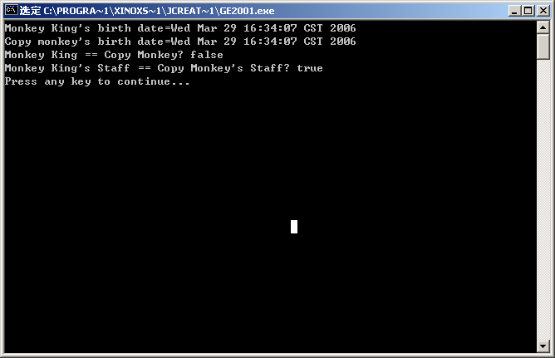
Shallow Clone 3

Slide 28
Deep Clone 4
Deep Clone
import java.io.Serializable;
import java.util.Date;
public class GoldRingedStaff implements Cloneable, Serializable
{
public GoldRingedStaff() { }
public void grow() {
this.diameter *= 2.0;
this.height *= 2;
}
public void shrink() {
this.diameter /= 2;
this.height /= 2;
}
public void move() { }

Slide 29
Deep Clone 4
public float getHeight() {return height; }
public void setHeight(float height) {this.height = height; }
public float getDiameter() {return diameter;}
public void setDiameter(float diameter) {
this.diameter = diameter;
}
private float height = 100.0F;
private float diameter = 10.0F;
}

Slide 30
Deep Clone 4
import java.util.Date;
public class Monkey implements Cloneable, Serializable
{
public Monkey() {
this.birthDate = new Date();
this.staff = new GoldRingedStaff();
}
public Object deepClone()
throws IOException, OptionalDataException, ClassNotFoundException {
//write to stream
ByteArrayOutputStream bo = new ByteArrayOutputStream();
ObjectOutputStream oo = new ObjectOutputStream(bo);
oo.writeObject(this);
//read from stream
ByteArrayInputStream bi = new ByteArrayInputStream(bo.toByteArray());
ObjectInputStream oi = new ObjectInputStream(bi);
return (oi.readObject());
}

Slide 31
Deep Clone 4
public int getHeight() {return height; }
public void setHeight(int height) {this.height = height; }
public int getWeight() {return weight;}
public void setWeight(int weight) {this.weight = weight;}
public Date getBirthDate() {return birthDate;}
public void setBirthDate(Date birthDate) {this.birthDate = birthDate;}
public GoldRingedStaff getStaff() {return staff;}
private int height;
private int weight;
private GoldRingedStaff staff;
private Date birthDate;
}

Slide 32
Deep Clone 4
import java.util.Date;
import java.io.IOException;
import java.lang.ClassNotFoundException;
public class TheGreatestSage
{
public void change() throws IOException, ClassNotFoundException {
Monkey copyMonkey;
for (int i = 0 ; i < 2000; i++){}
copyMonkey = (Monkey) monkey.deepClone();
System.out.println("Monkey King's birth date=" + monkey.getBirthDate() );
System.out.println("Copy monkey's birth date=" + copyMonkey.getBirthDate() );
System.out.println("Monkey King == Copy Monkey? " + (monkey == copyMonkey));
System.out.println("Monkey King's Staff == Copy Monkey's Staff? " +
(monkey.getStaff() == copyMonkey.getStaff()));
}
public static void main(String[] args) throws IOException, ClassNotFoundException
{
TheGreatestSage sage = new TheGreatestSage();
sage.change();
}
private Monkey monkey = new Monkey();
}

Slide 33
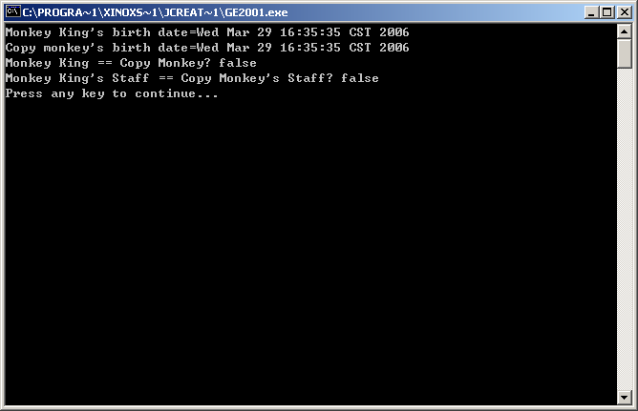
Deep Clone 4

Slide 34
The Prototype Method Pattern
Related creation design patterns
  Abstract Factory (AF)
    Specification of a hierarchy of factory-creating classes that parallel the product classes being created
    Allows run-time parameter specification to determine which concrete factory will create system objects.
    Can be combined with Prototype design:
      AF stores a set of prototypes to clone, returning product objects
      Similar to a registry for storing and managing prototypes

Slide 35
The Prototype Method Pattern
Factory Method (FM)
  Creation design pattern for classes, not objects
    Uses a hierarchy of factory creating classes that parallel the concrete product classes being created
    Does not support dynamic object creation
Builder
  Builder class created for each product class
    Hiding the creation complexity
    Product creation logic is not in the product class
Singleton, Composite, Decorator
  Can be used in the implementation of a Prototype pattern

Slide 36
References
Elena Fanea and David Baker, "Prototype Design Pattern", http://pages.cpsc.ucalgary.ca/~faneael/Prototype_document.html
James Cooper , "The Design Patterns Java Companion", http://www.patterndepot.com/put/8/Prototype.html
http://www.dofactory.com/patterns/Patterns.aspx
http://www.dofactory.com/patterns/PatternPrototype.aspx
http://www.clickblocks.org/patterns1/pattern_synopses.htm

Slide 37
Summary
In this lesson, you learnt:
Prototype Pattern

